Slide 1




BIOM 262: 2/23/2016
Modern Applied Population Genetics
Nicholas J. Schork, Ph.D.
(JCVI, UCSD, La Jolla, CA; TGen, Phoenix AZ)
Views on Global Human Genetic Variation and Lewontin’s Studies/Fallacy
2. Global Human Functional Genomic Diversity: Stratification and Its Consequences
3. Admixture: Characterization, Consequences and Admixture Mapping
Population Genetics and Evolutionary Genetics: Integration and Impact

Slide 2
1. Views on Global Human Genetic Variation and Lewontin’s Studies/Fallacy

Slide 3
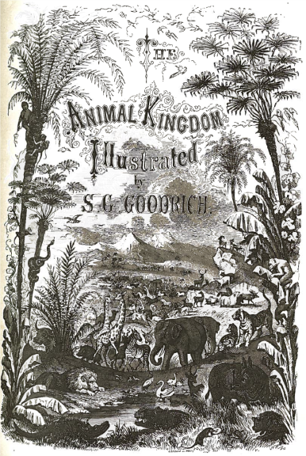
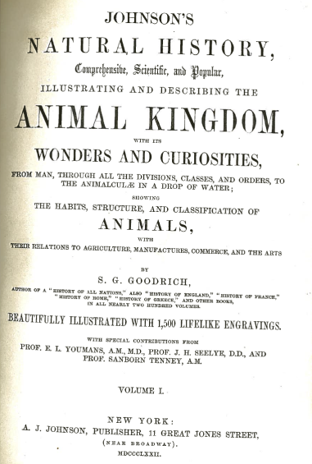
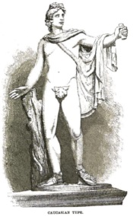
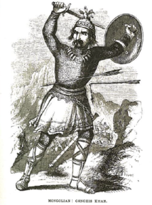
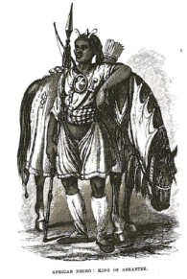
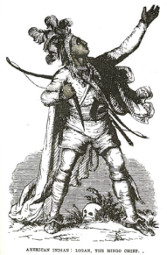
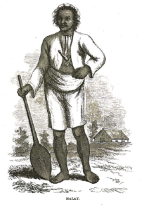
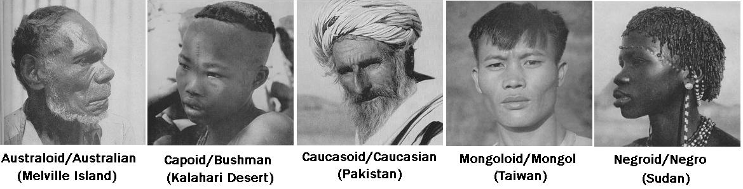
Previous Views on Global Human Genetic Variation
and Lewontin’s Study
Caucasian Mongol African Amerindian Malay

Slide 4
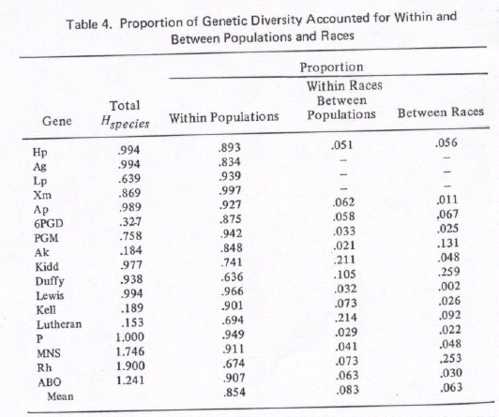
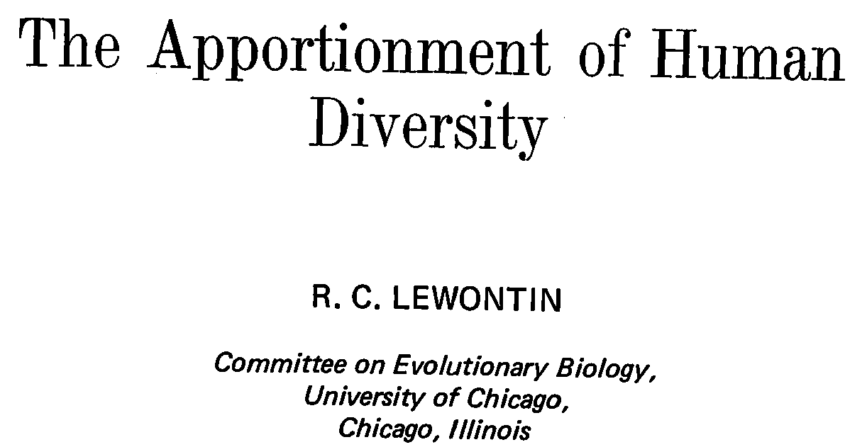
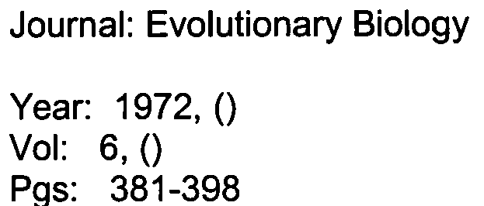
Lewontin’s Study and Global Genetic Variation

Slide 5
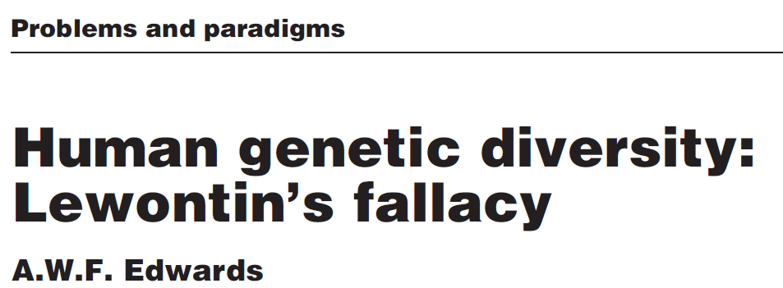
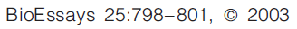
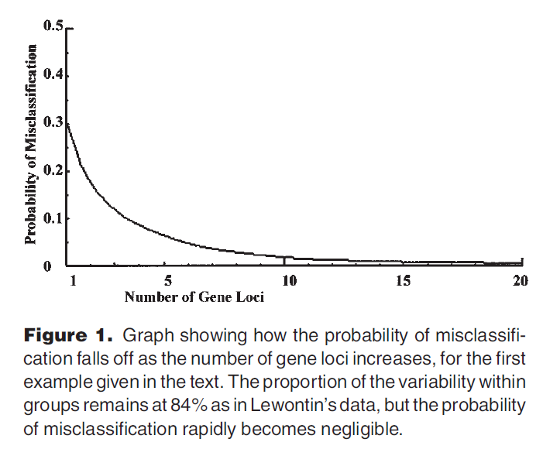
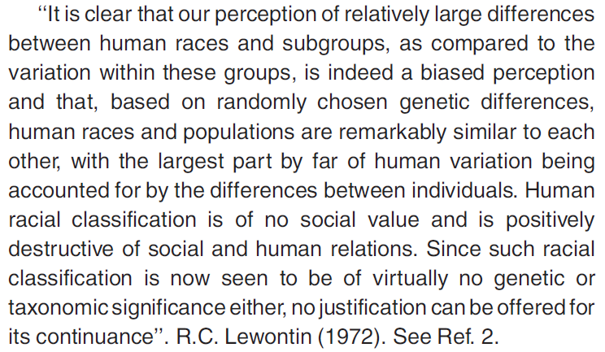
Lewontin’s 15.0% is > 0.0%, So Classification is Possible!

Slide 6
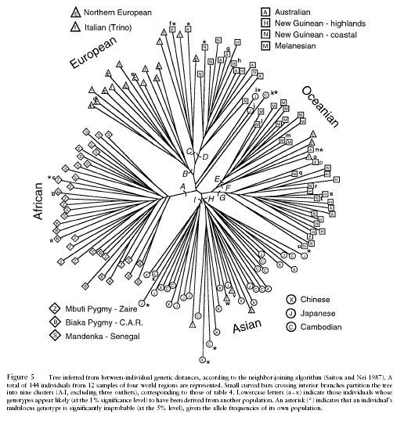
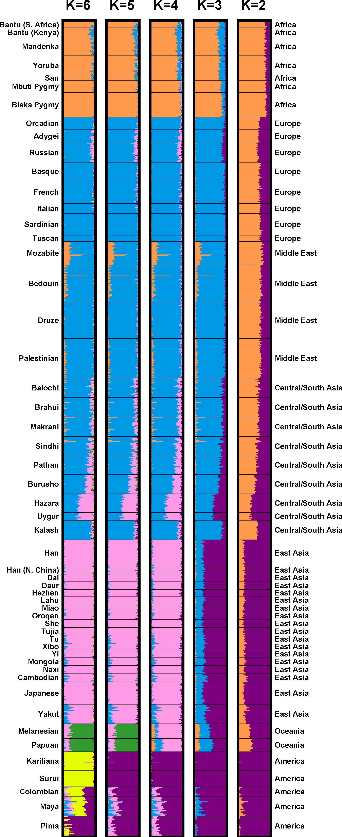
Contemporary ‘Unsupervised’ Studies of Global Human Genetic Diversity
Individuals from the same population tend to cluster together
Mountain and Cavalli-Sforza, Am. J. Hum. Genet. 1997
assumptions about the different number of “groups” (color coded) tended to cluster together people from the same population
Rosenberg et al. Science 2004

Slide 7
Representing Human Genomic Diversity via Similarity ‘Trees’
1
2
Genotype Similarity:
AA GG AA CC AA
AT GG GA CC CC
6/10=0.60
1 2 1 2 0
N x N Distance Matrix
0.00 0.76 0.54 … 0.90
0.76 0.00 0.43 … 0.63
0.54 0.43 0.00 … 0.32
…
0.90 … 0.00
3
3
Figure 1. Neighbor-joining trees depicting the genetic relationships of 1040 individuals from 51 world populations collected by the HGDP. In figure 1a individuals are color coded according to which of five major geographic regions of the globe they are collected from, and in figure 1b, according to which of the 51 populations they are associated with (key: 1: Biaka Pygmy, 2: San, 3: Mbuti Pygmy, 4: Druze; 5: Bedouin, 6: Mozabite, 7: Palestinian, 8: Kalash, 9: Pima, 10: Columbian, 11: Karitiana, 12: Surui, 13: New Guinea, 14: Yakut).

Slide 8
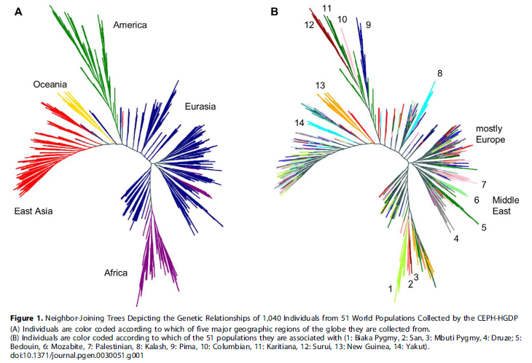
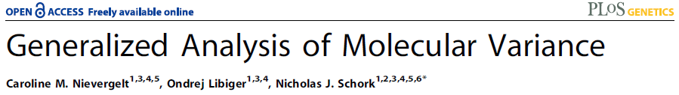
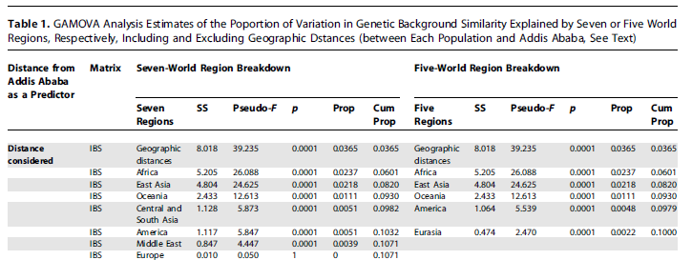

Slide 9
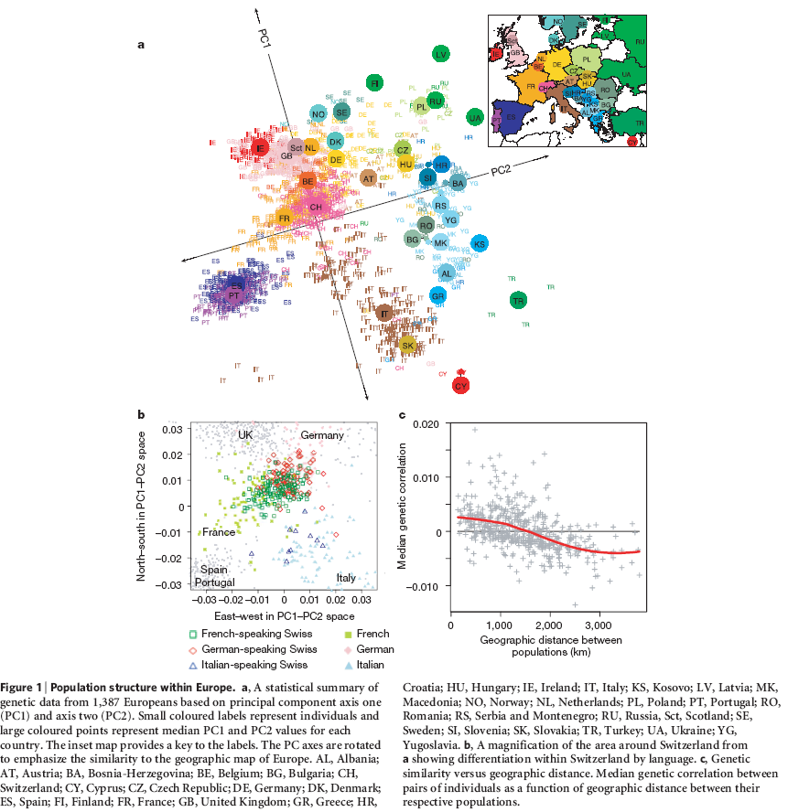
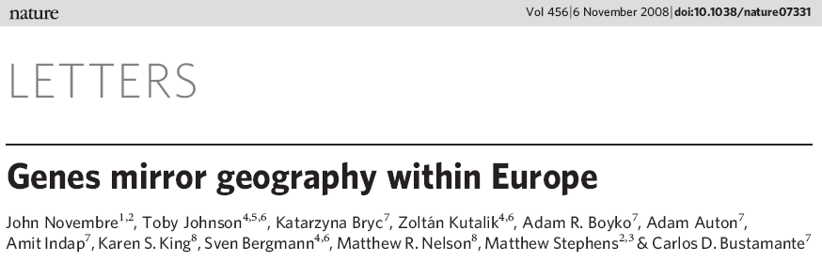
With Enough Markers, Populations Can Be Distinguished

Slide 10
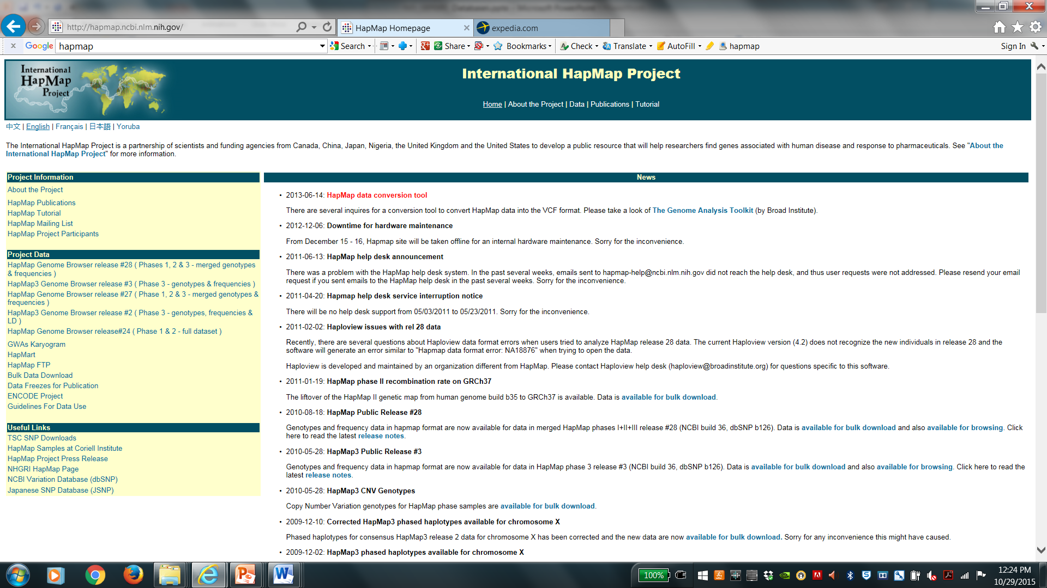
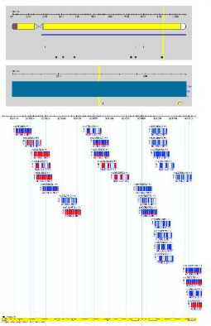
International HapMap Database: http://hapmap.ncbi.nlm.nih.gov/

Slide 11
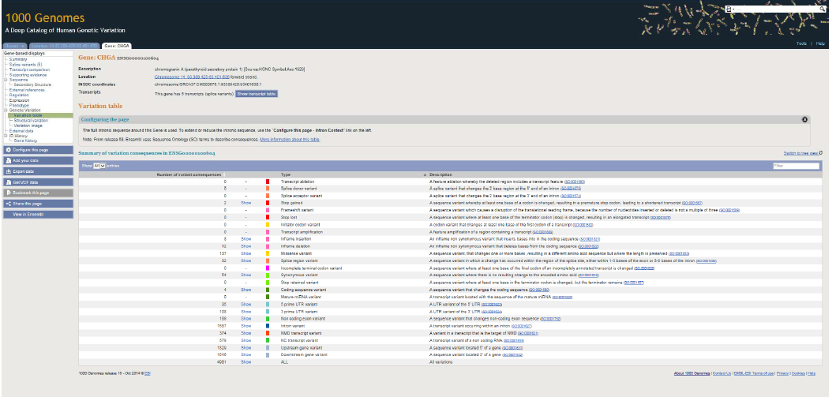
1000 Genomes Project: http://www.1000genomes.org/

Slide 12
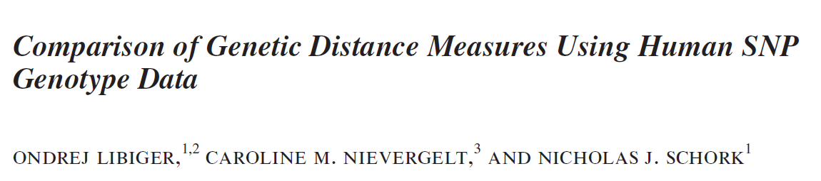
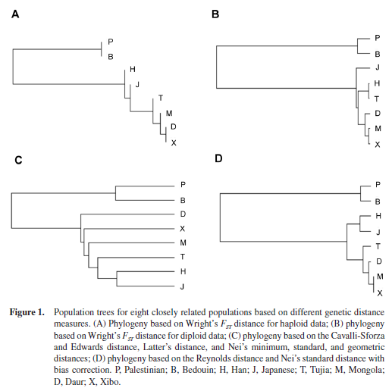
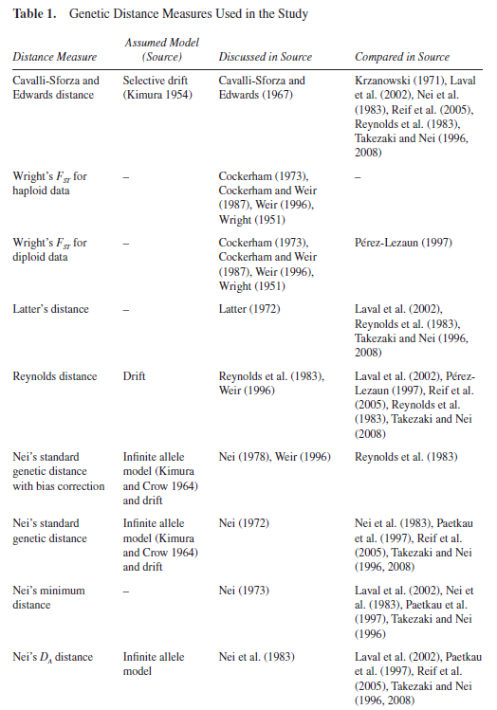
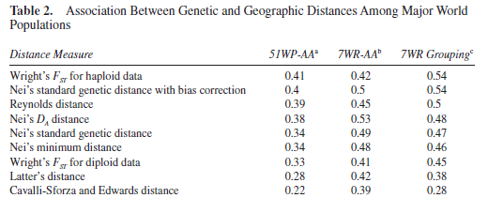
Genetic Distance Measures Make Different Assumptions…

Slide 13
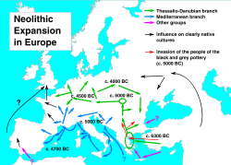
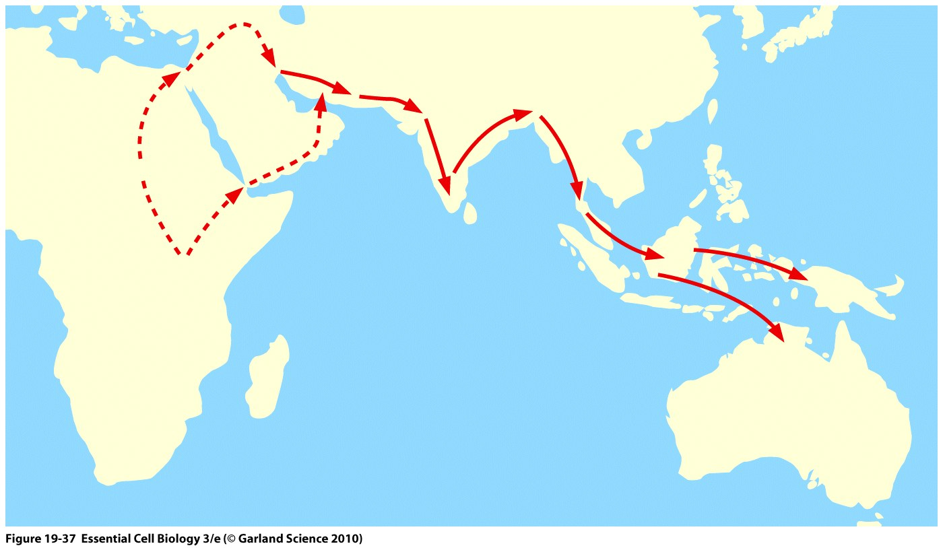
Migration and Admixture Push Initial Heterogeneity but Move Towards Equilibrium

Slide 14
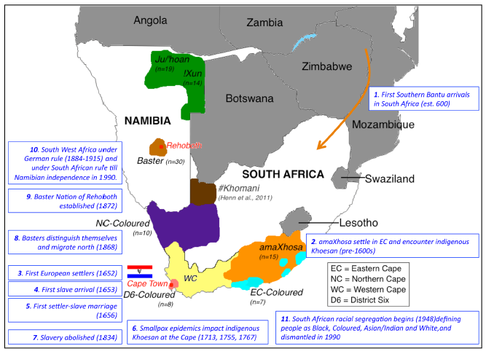
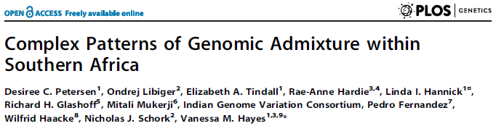
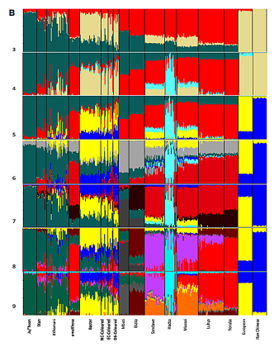
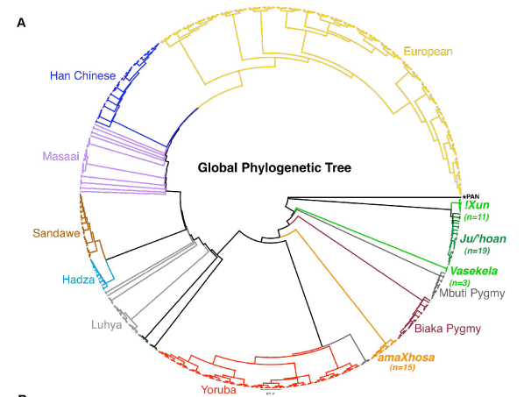

Slide 15
Hardy-Weinberg Equilibrium (1908): Population Diagnostics
For a two allele system (‘A’ and ‘a’) for autosomal locus:
p=frequency of allele A
q=frequency of allele a
If a population is in Hardy-Weinberg Equilibrium, then:
Frequency of the AA genotype = p²
Frequency of the aa genotype = q²
Frequency of the Aa (aA) genotype = 2pq
This is obtained from a simple Binomial expansion for frequencies of genotypes AA, Aa and aa:
(p + q)² = p² + 2pq + q²
These frequencies will remain constant over generations w/o forces

Slide 16
Genotype Frequencies: CCR5 and Deletion Allele
ΔCCR5 allele: 32 bp deletion in cytokine gene, non-functional
ΔCCR5/ΔCCR5 homozygotes are resistant to HIV infection
Genotype Number of People Relative Genotype Frequency
CCR5/CCR5 647 0.8210
CCR5/ΔCCR5 134 0.1682
ΔCCR5/ΔCCR5 7 0.0108
CCR5 allele frequency: [(2 x 647) + (1 x 134)] / (788 x 2) = 0.906
ΔCCR5 allele frequency: 1 - CCR5 allele frequency = 1 - 0.906 = 0.094
Note: for an x-linked locus calculations are different

Slide 17
Deviations from Hardy-Weinberg Equilibrium
Assumptions for HWE:
Population is large, matings are random with respect to locus in question.
Allele frequencies remain constant over time:
No appreciable rates of mutation.
Individuals of all genotypes are equally likely and capable of mating (i.e., no selection against any genotype).
No significant immigration into or emigration out of the population to vary allele frequencies.
These assumptions are rarely met in human populations.
Hardy-Weinberg Law is still useful in spite of deviations from these assumptions (especially for AR conditions).
If deviation from Hardy-Weinberg equilibrium, one can determine why.
Exceptions to random mating (can cause large deviations in incidence of AR disorders)
Stratification of population
Assortative mating (mating based on phenotype)
Consanguinity (‘inbreeding’; mating with relatives at some level)
Mutation
Selection
Migration

Slide 18
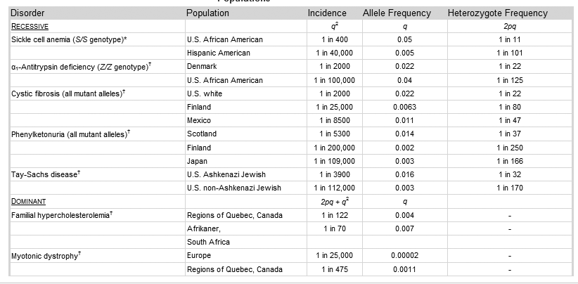
Diseases That Exhibit Allele Frequency Differences

Slide 19
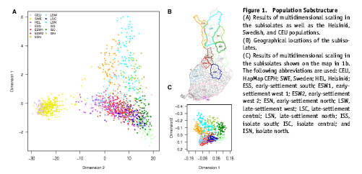
Population Genetic Substructure in Finland The population in Finland was originally quite isolated, and it expanded over 10-fold in the past 300 years. The isolation and population expansion allowed the population to develop a distinctive pattern of single-gene disorders.

Slide 20
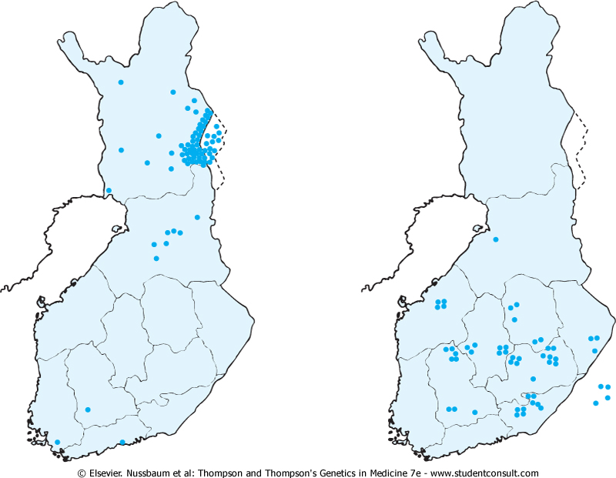
Population Genetic Substructure in Finland: Diseases
Choroideremia
Hyperornithinemia
with Gyrate Atrophy
The geographical origin of cases of two genetic disorders prevalent in Finland: X-linked choroideremia (left) and hyperornithinemia with gyrate atrophy of the choroid and retina (right). Most cases of each disease originate from particular communities in Finland, but the distributions of the diseases differ. (Based on Mitchell GA, Brody LC, Sipila I, et al: At least two mutant alleles of ornithine-δ-aminotransferase cause gyrate atrophy of the choroid and retina in Finns. Proc Natl Acad Sci USA 86:197-201, 1989; and Nario R, Nevanlinna HR, Perheentupa J: Hereditary diseases in Finland: rare flora in rare soil. Ann Clin Res 5:109-141, 1973.)

Slide 21
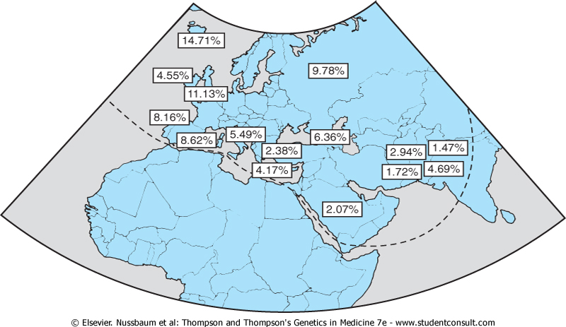
ΔCCR5 Variant Exhibits Global Frequency Differences
Figure 9-10 Frequency of ΔCCR5 alleles in populations from Europe, the Middle East, and the Indian subcontinent. (From Martinson JJ, Chapman NH, Rees DC, et al: Global distribution of the CCR5 gene 32-basepair deletion. Nat Genet 16:100-103, 1997.)

Slide 22
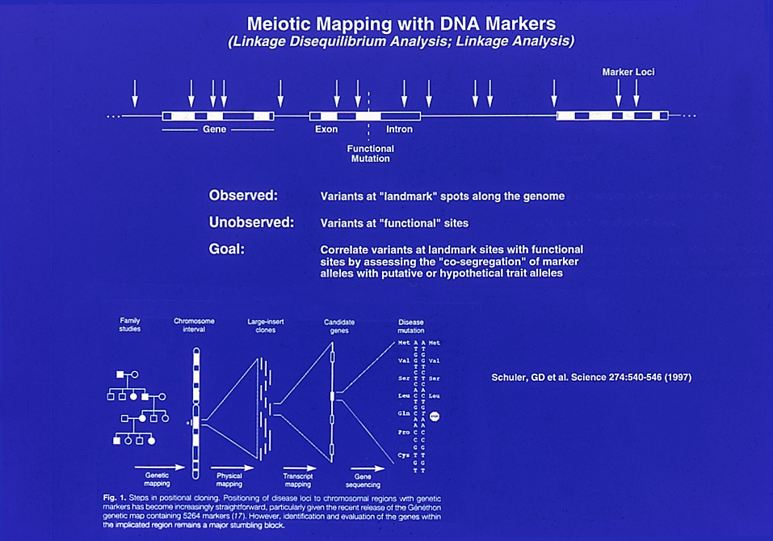

Slide 23
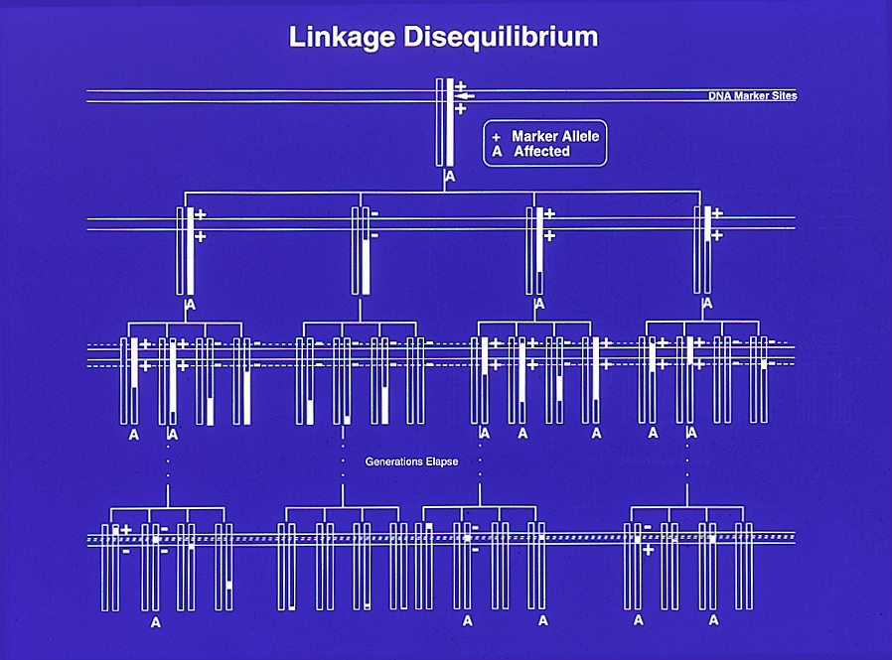
Mapping with Unrelated Individuals using Linkage Disequilibrium
Founder chromosome with “ancestral” variant
“Linkage Disequilibrium (LD)” between the “+” allele and the disease mutation
No more LD…

Slide 24
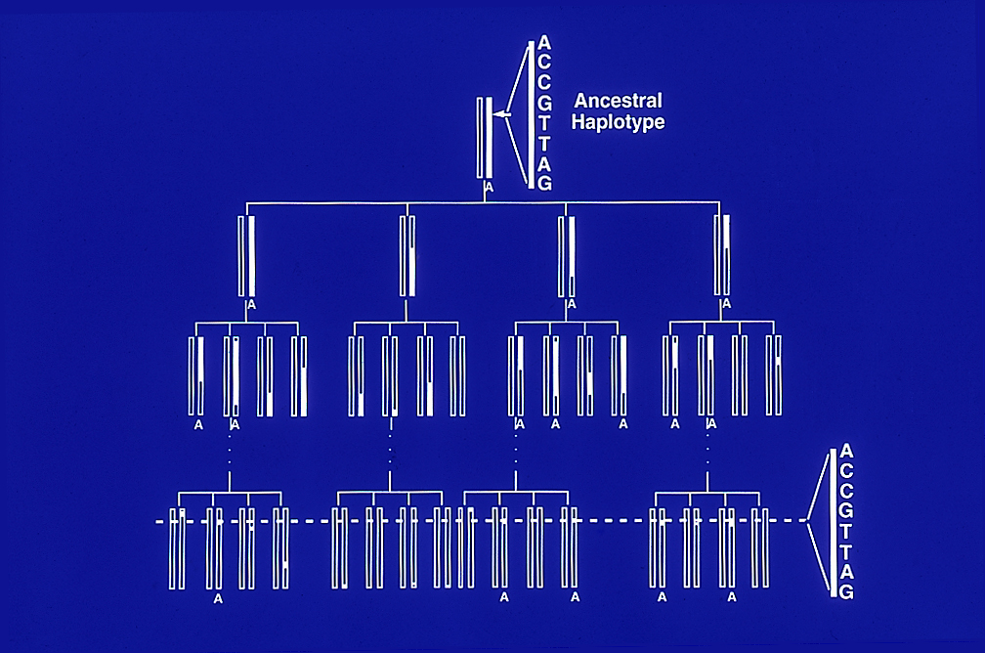
Association Mapping for Gene Discovery via Linkage Disequilibrium
Intuition: a ‘signature pattern of alleles’ can mark chromosomes

Slide 25
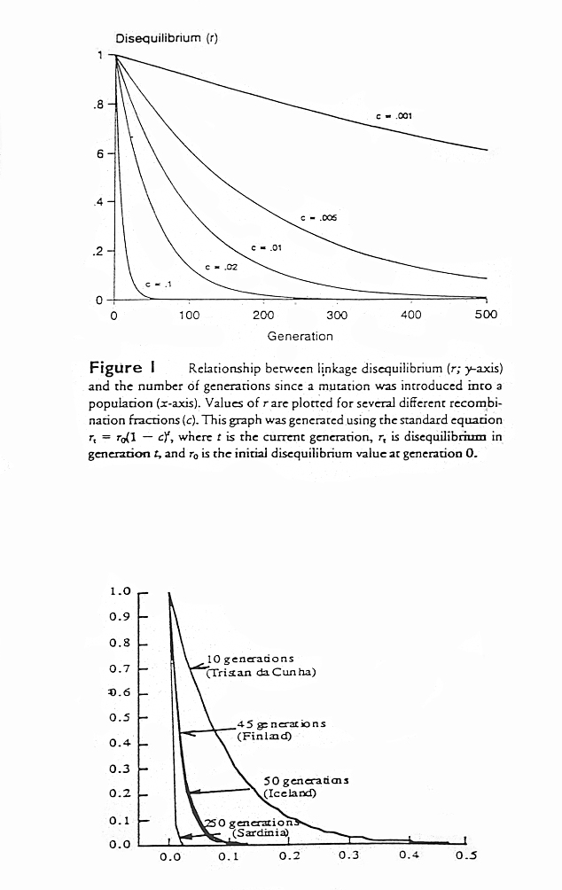
Theoretical Relationship Between LD and Recombination
NOTE: Only recombination is taken into account

Slide 26
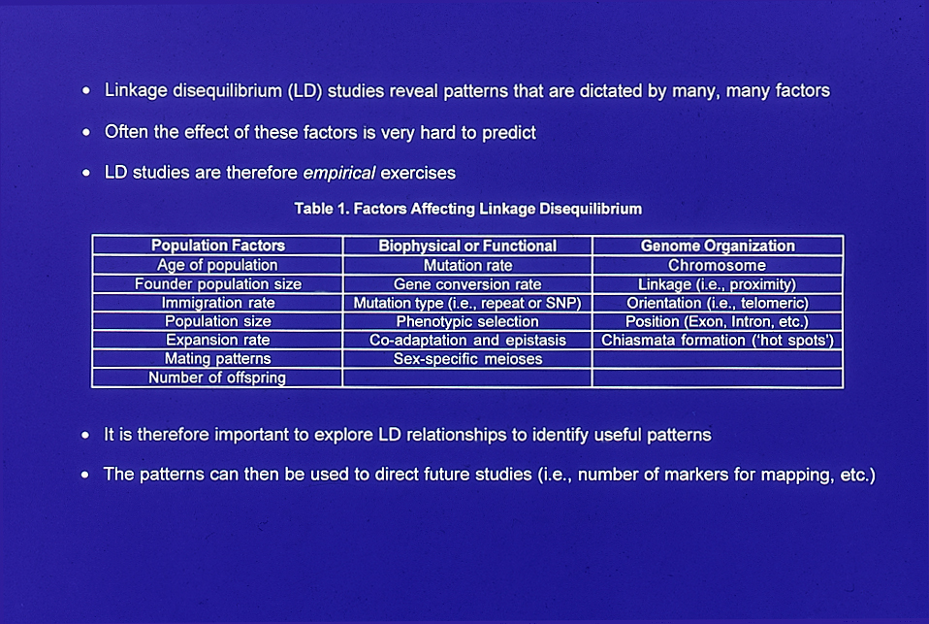
Many Factors Influence Linkage Disequilibrium Over-and-Above Recombination

Slide 27
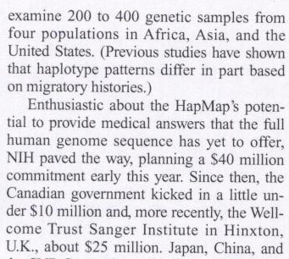
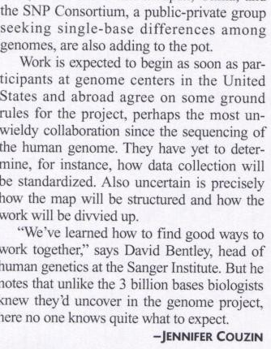
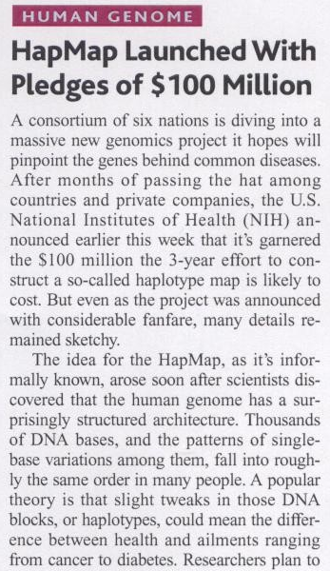
International Haplotype Map (‘HapMap’) Project (www.hapmap.org)
Multimillion Dollar Effort
Multinational Effort (Second Generation Human Genome Project)
Goals: Define block structure of the genome based on LD patterns major populations
Expected Outcomes:
Information about locus redundancies (genotyping efficiency)
Information about genome organization
Information about population genetic phenomena
Facilitate gene discovery(?)

Slide 28
Linkage Disequilibrium Mapping and Haplotype ‘Blocks’
Haplotype (LD) Block
Weak LD
Strong LD
…ACTAGATCGATCAGTTAGCTCTTAGACATCAGCTACCAGCTACGATAGCTAACAACCTATCATTTTCAGGGCGAATGCAGATA…
…ACTAGATCGATCAGTTAGCTCTTAGACATCAGCTACCAGCTACGATAGCTAACAACCTATCATTTTCAGGGCGAATGCAGATA…
…ACTAGATCGATCAGTTAGCGCTTAGACATCAGCTACCTGCTACGATAGCTAACAACCTCTCATTTTCAGGGCGAATGCAGATA…
…ACTAGATCGATCAGTTAGCGCTTAGACATCAGCTACCAGCTACGATAGCTAACAACCTATCATTTTCAGGGCGAATGCAGATA…
…ACTAGATCGATCAGTTAGCTCTTAGACATCAGCTACCAGCTACGATAGCTAACAACCTATCATTTTCAGGGCGAATGCAGATA…
…
…ACTAGATCGATCAGTTAGCTCTTAGACATCAGCTACCAGCTACGATAGCTAACAACCTCTCATTTTCAGGGCGAATGCAGATA…
Disease
(‘Cases’)
…ACTAGGTCGATCAGCTAGCTCTTAGACATCAGCTACCAGCTACGATAGCTAACAACCTATCATTTTCAGGGCGAATGCAGATA…
…ACTAGGTCGATCAGCTAGCGCTTAGACATCAGCTACCAGCTACGATAGCTAACAACCTATCATTTTCAGGGCGAATGCAGATA…
…ACTAGGTCGATCAGCTAGCGCTTAGACATCAGCTACCAGCTACGATAGCTAACAACCTATCATTTTCAGGGCGAATGCAGATA…
…ACTAGGTCGATCAGCTAGCTCTTAGACATCAGCTACCAGCTACGATAGCTAACAACCTATCATTTTCAGGGCGAATGCAGATA…
…ACTAGGTCGATCAGCTAGCGCTTACACATCAGCTACCAGCTACGATAGCTAACAACCTATCATTTTCAGGGCGAAGGCAGATA…
…
…ACTAGGTCGATCAGCTAGCGCTTACACATCAGCTACCAGCTACGATAGCTAACAACCTATCATTTTCAGGGCGAATGCAGATA…
Normals
(‘Controls’)
Common Variations
Rare Variations

Slide 29
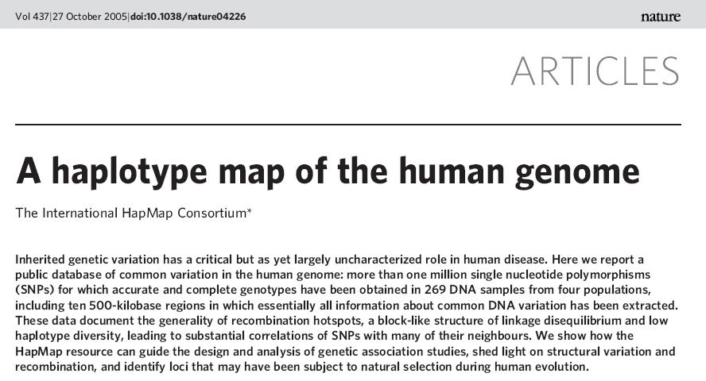
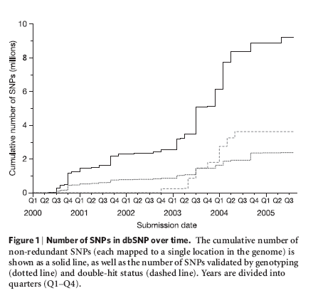

Slide 31
Science May 11, 2007 (Vol 316)

Slide 32
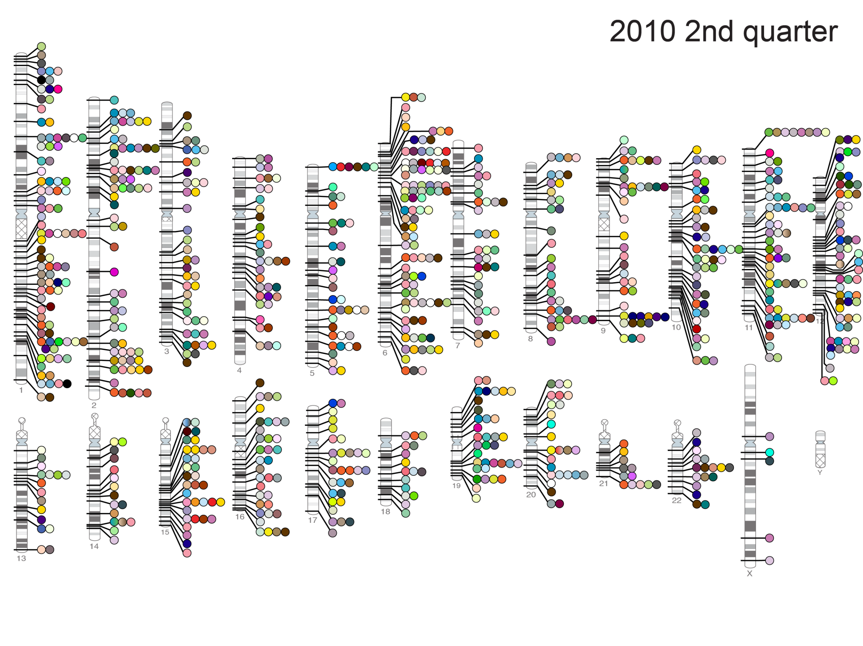
Published Genome-Wide Associations through 6/2010
(904 published GWAS hits at p<5x10⁻⁸ for 165 traits)
Blood Pressure; Coronary Disease; HDL; Heart Rate; LDL; Obesity; Total Cholesterol; T2D
NHGRI GWA Catalog (www.genome.gov/GWAStudies)

Slide 33
2. Global Human Functional Genomic Diversity: Stratification and its Consequences

Slide 34





Idiopathic Diseases: Genomics Can Help…
Rare Genomics Institute: www.RareGenomics.org

Slide 35
Finding the Causative Variants for Idiopathic Disease: Filters
Two reasonable(?) assumptions:
The pathogenic variant(s) is ‘novel’ (i.e., unique to the patient)
The effect of the variant is pronounced enough to be characterized bioinformatically since there will be too many variants not functionally characterized via lab experiments
Novel Variant in Functional Element
…C G A T C A…
C G A T C A
1. Novel
2. Damaging
3. Relevant
Pathway
4. No
Compensatory
Mechanism
5. Pathogenic
Patient
Reference
genomes
…ACGCCGTCAGGGTCATAGTAGACTAGCTTGAGCTACCAAA…
…ACGTCGTCAGGGTCATCGTAGACTAGCTAGAGCTAGCATA…
…ACGTCGTCAGGCTCATAGTAGACTAGCTAGAGCTAGCATA…
…ACGTCGTCAGGCTCATAGTAGACTAGCTAGAGCTAGCAAA…
…ACGCCGTCAGGCTCATCGTAGACTAGCTAGAGCTAGCATA…
…ACGTCGTCAGGCTCATAGTAGACTAGCTAGAGCTAGCATA…
…ACGTCGTCAGGCTCATAGTAGACTAGCTAGAGCTAGCATA…
…ACGCCGTCAGGCTCATCGTAGACTAGCTAGAGCTACCATA…
…ACGTCGTCAGGCTCATCGTAGACTAGCTAGAGCTAGCATA…
…ACGCCGTCAGGCTCATAGTAGACTAGCTAGAGCTAGCATA…
…ACGTCGTCAGGCTCATCGTAGACTAGCTAGAGCTAGCAAA…
…ACGTCGTCAGGCTCATCGTAGACTAGCTAGAGCTACCATA…
G A T C
G A T
A T
T
What bioinformatic tools should be used for functionality? Does it make a difference?
What reference populations for determining novelty should be used? Does it matter?

Slide 36

Functional Annotations: Bioinformatic Predictions
Splice Change
Frameshift Structural Variants
Nonsense SNVs
Damaging ns cSNPs
Transcription
Factor Binding
Disrupting
Exonic Splicing
Silencer
Protein Motif Damaging
microRNA
Binding Site
Disrupting
Exonic Splicing
Enhancer
Plumpton and Barnes. “Predictive Functional Analysis of Polymorphisms: An Overview.” in Bioinformatics for Geneticists. Wiley, 2007
We have developed methodology and tools for comprehensive bioinformatic WGS annotation
(Schork, Torkamani and colleagues: Bioinformatics 2008, 2009; Cancer Research (2009), Nat Gen Rev (2010), Genomics (2011))

Slide 37



Functional Annotations: The Limits of Conservation
Torkamani, Kannan, Taylor, Schork. PNAS 105:9011-9016; 2008
Positions (residues/amino acids) of ~1000 disease causing variants in kinase proteins contrasted with the positions of ~1000 kinase variants not known to cause disease
Torkamani, Schork
SIFT
Review: Lahiry, Torkamani, Schork, Hegele. Nature Reviews Genetics 11; 2010
Cancer Predictions: Torkamani, Schork. Cancer Research 68; 2008

Slide 38




Available Whole Genome Sequences for Diversity Studies
http://archaeology.about.com/od/stoneage/ss/tishkoff_2.htm
CE=9
TS=4
JP=4
CH=4
MX=5
AS=5
GI=4
LW=4
YR=9
MK=4
We compared the number of type of DNA sequence variants between individuals from different ethnic groups
Implications for comparing and contrasting individual genomes

Slide 39
Population Differences in Variant Frequency and Type
----- Africa ----- Europe Asian Admixed
----- Africa ----- Europe Asian Admixed
----- Africa ----- Europe Asian Admixed
----- Africa ----- Europe Asian Admixed
Historical bottlenecks, migrations, founder effects, random inbreeding, lack of time for selective pressure to operate, etc. have left an imprint on contemporary global standing variation and homozygosity in non-African populations on a WGS functional variant basis (extends the work of Bustamante et al.)

Slide 40
Regression Analyses: All Functional Variant Types
Rate of Variant Type Per Genome: Negative Coefficient = Lower Rate; Positive = Higher Rate
Non-Africans differ from Africans in variant frequencies across virtually ALL functional variant categories
More variation in all functional elements in African genomes
More homozygous functional variation in non-African genomes

Slide 41


How Often Can One be Misled Using the Wrong Reference?
We ‘implanted’ known disease causative variants with Polyphen2 score > 0.8 in genomes
Determined the observed number of novel functional variants with different reference
Determining the novelty of a variant requires ancestry-appropriate reference genomes…
This has implications for clinical studies searching for variants for idiopathic conditons

Slide 42




Genetic Differentiation Phenotypic Differentiation
Cavelaars 2000
Craniofacial Variation/Differentiation

Slide 43
Example low frequency populations
Example high frequency populations

Slide 44




Slide 45

Hypothesis:
Brain size, as with skull size, shows variation consistent with historical migratory patterns in Europe (i.e., skull size and brain size are correlated but with what else?)
Two Data Sets:
Skulls obtained from individuals living in different European communities
Brain images from individuals whose ancestry was determined via genetic markers
Basic Analysis Strategy:
Correlate skull and brain size with major sources of population/individual genetic differentiation that reflect migratory patterns

Slide 46


Historical Human Migrations and Settlements
European SE to NW Migratory ‘Axis’

Slide 47


Genetic Background Correlates w/ Cranial Structure
The more similar the genetic background, the more similar the cranial features
Martinez-Abadias 2009

Slide 48

Cranial Morphology Spatially Structured in Europe
Martinez-Abadias 2009
1154 male skulls from 26 populations across Europe, N>10 per population
37 neurocranial and facial length measurements
85% of skulls had complete data (all had at least 34/37)
Bakken, Dale, Schork, ADNI (2011)

Slide 49

Analysis Suggests Variation Spatially Structured
Bakken, Dale, Schork, ADNI (2011)
Notes:
Mahalanobis distance

Slide 50

Several Cranial Lengths Vary Along NW–SE Axis
Bakken, Dale, Schork, ADNI (2011)
Notes:
Sokal1987 see an increase in cranial length (GOL) along this axis too

Slide 51


1387 European individuals
Self reported ancestry based
Affy 500k genotyping
Major axis of variation: NNW–SSE
Consistent with historical migration

Slide 52
ADNI Data for Brain Morphology/Ancestry Analysis
Ancestry Estimation:
626 Individuals with MRI phenotypes
PLINK33 software used to estimate ancestry
34 European reference populations from POPRES, HGDP, and HapMap
59,908 SNPs after filtering based on quality and linkage disequilibrium
NW–SE Genetic Admixture Assessment:
project rotated principal components onto a 45° line running NW-SE
NW–SE Admixture was Tested for Association With:
12 brain region summary measures
cortical area in 66 regions
cortical area across the surface of the brain
univariate linear models controlling for sex, age, height, weight, BMI, and
neurological diagnosis.
Bakken, Dale, Schork, ADNI (2011)

Slide 53

NW–SE Admixture Explains Small Variation in Brain Measures Independently of Height
ICV
Cortical Area
p = 2.5e-4
p = 5.2e-5, R² = 0.03
NW
SE
NW
SE
Covariates: Age, sex, diagnosis, height, BMI (these effects were eliminated!)
No association with: hippocampal volume, cortical thickness, cerebellar volume
Bakken, Dale, Schork, ADNI (2011)

Slide 54

NW–SE Admixture Explains Small Variation in Brain Measures Independently of Height
Bakken, Dale, Schork, ADNI (2011)

Slide 55
Anterior Shift in Cortical Areas Along NW–SE Axis
Hemi | Lobe | Region | P-value
R | Frontal | lateralorbitofrontal | 1E-06
R | Temporal | superiortemporal | 2E-06
R | Frontal | rostralmiddlefrontal | 5E-05
R | Occipital | lateraloccipital | 6E-05
L | Temporal | superiortemporal | 8E-05
L | Cingulate | rostralanteriorcingulate | 1E-04
R | Frontal | caudalmiddlefrontal | 1E-04
L | Frontal | superiorfrontal | 2E-04
L | Frontal | lateralorbitofrontal | 2E-04
R | Temporal | transversetemporal | 2E-04
L | Frontal | parsopercularis | 3E-04
L | Occipital | lateraloccipital | 4E-02
R | Cingulate | rostralanteriorcingulate | 2E-01
Bakken, Dale, Schork, ADNI (2011)

Slide 56

Frontotemporal Regions Are Most Affected by NW European Genetic Background.
Color maps that indicate nominal -log10(P-value) of association between NW–SE admixture and cortical area across the reconstructed cortical surface, while controlling for height, weight, BMI, age, sex, and diagnosis.
Bakken, Dale, Schork, ADNI (2011)

Slide 57


http://ping.chd.ucsd.edu/
The Influence of Ancestry on Pediatric Neuroimaging Phenotypes
Cinnamon S. Bloss, Ondrej Libiger, Ph.D., Burcu F. Darst, Andrew J. Schork, J. Cooper Roddey, Natacha Akshoomoff, David G. Amaral, B.J. Casey, Linda Chang, Thomas M. Ernst, Jean Frazier, Jeffrey R. Gruen, Walter E. Kaufmann, Brian Keating, Tal Kenet, Joshua M. Kuperman, David N. Kennedy, Sarah S. Murray, Stewart Mostofsky, Elizabeth R. Sowell, Peter Van Zijl, Terry L. Jernigan, Anders M. Dale and Nicholas J. Schork, Ph.D.
Pediatric Imaging, Neurocognition and Genetics (PING) Study: Large Pediatric Study
Focus is comprehensive neuroimaging, cognitive measures and GWAS data
Large (1200+) study involving individuals with a diverse ancestries
European, African, Native American, East, Asian, Oceanic, Central Asian
Libiger et al. manuscript in preparation

Slide 58


Correlations Between Degree of Admixture and Neuroanatomy
(Including and Excluding Non-Admixed Individuals; PING data)
Simple correlations: TCA vs. admixture
(Covariates: linear age, quadratic age, cubic age, sex, income and highest parental education and scanner (TCA, MCT and ICV))
GAMOVA results:
Africans (most divergent from others)
East Asians (next most divergent)
Native American (next most divergent)
European (next most divergent)
Central Asian (least divergent)
Residual genetic variation associated with cortical area = ~2% (p=0.009)
p<0.0007
p<0.0000006
Libiger et al. manuscript in preparation

Slide 59


Correlations Between Degree of Admixture and Neuroanatomy
(Including and Excluding Non-Admixed Individuals; PING data)
Correlations with only admixed individuals:
No overt environmental differences between ‘pure’ groups
Environmental exposure would have to track with degree of admixture?
Multiple ancestries contributing to admixture make an environmental correlate unlikely
p<0.002
Libiger et al. manuscript in preparation

Slide 60
Correlations Between Degree of Admixture and Neuroanatomy
(Including and Excluding Non-Admixed Individuals; PING data)
Correlations likely influenced by a polygenic effect, not just environmental differences
Libiger et al. manuscript in preparation

Slide 61
The Implications of Ancestry for Neuroimaging-Guided Pediatric Diagnoses
Cinnamon S. Bloss, Ph.D.,*^{1,2} Ondrej Libiger, Ph.D.,*^{1,3} Burcu F. Darst, B.S.,^{1,2} Andrew J. Schork, B.S., ⁴ J. Cooper Roddey, Ph.D., ⁴ Natacha Akshoomoff, Ph.D.,⁴ David G. Amaral, Ph.D.,⁵ B.J. Casey, Ph.D.,⁶ Linda Chang, M.D.,⁷ Thomas Ernst, Ph.D.,⁷ Jeffrey R. Gruen, M.D.,⁸ Walter E. Kaufmann, M.D.,⁹ Tal Kenet, Ph.D.,¹⁰ David N. Kennedy, Ph.D.,¹¹ Sarah S. Murray, Ph.D., ^{1,3} Elizabeth R. Sowell, Ph.D.,¹² Anders Dale, Ph.D., ^{¶,4} Terry L. Jernigan, Ph.D., ^{¶,4} & Nicholas J. Schork, Ph.D., ^{¶,1,3,13}
Presented at the 2012 UCI International Imaging Genetics Conference
Figure 2: Age and sex adjusted distribution of total cortical area and mean cortical thickness in individuals with various genetic ancestry.
Libiger et al. manuscript in preparation

Slide 62
Population Stratification and False Positive Associations
Population 1 Population 2
-
-
-
+
-
+
+
+
+
-
-
+
-
-
+
+
-
+
+
+
-
+
-
+
-
-
+
+
-
+
-
-
+
+
-
-
-
-
+
-
+
-
-
+
+
+
+
-
-
+
Diseased = Shaded: ; Non-Disease = Non-Shaded:
Differential frequency of the +/- alleles between the populations
+
+
+
+
+
+
-
-
-
-
-
-
Cases Controls
(+: 6/6) (+: 0/6)

Slide 63
The Transmission Disequilibrium Test (TDT)
TA
AA
The TDT tests the frequency with which a particular allele is transmitted to an affected offspring from a heterozygous parent (normally 50% probability)
The TDT requires no control group (the untransmitted allele is thus the ‘control’)
TA
By not requiring a control group, the TDT avoids the problem of stratification for genetic association studies
In addition, the TDT avoids the need to identify appropriate controls
However, the TDT does not easily accommodate epidemiologic investigations involving multiple genetic and non-genetic factors or interactions

Slide 64
Stratification: No Longer an Issue?
One can genotype the individuals in an association analysis at many, many loci. The genotype information can then be used to essentially ‘cluster’ the individuals
The resulting cluster group memberships can then be used as ‘covariates’ in a genetic association analysis to control for potential stratification or heterogeneity
Alternatively, to control for heterogeneity, one might consider sampling from an isolated population with a restricted gene pool
The use of cluster membership as covariates is akin to standard epidemiologic practice of controlling for confounders, such as race, although the practice of using race as a surrogate for genetic background is problematic due to admixture
Admixture (i.e., the mating of individuals from different populations) can be accommodated via ‘Ancestry Informative Markers’ or ‘AIMs’

Slide 65


Example Methods Used to Sort Out the Genetic
Backgrounds of Individuals in a Sample

Slide 66
Questions?

Slide 67
3. Admixture: Characterization, Consequences and Admixture Mapping

Slide 68



Slide 69

Genetic variants that unique, or more common in, certain populations have been identified
Panels of such markers that have “population specific alleles” in them have been devised
These markers are “ancestry informative” for the population they have been chosen to be unique or more common in
An individual can be genotyped for these markers
The number of variations an individual possesses that are associated with the population in question is an estimate of the degree of ancestry for that person for that population
Repeating this for many population specific AIMs can be used to estimate how “admixed” an individual is

Slide 70



Example Admixture Studies Using AIMs: African Americans and Costa Ricans
Chicago African Americans
(Halder, Shriver, et al. unpublished)
Costa Ricans
(Shriver, et al. unpublished)
African Americans have genomes ‘between’ West Africans and Europeans but vary in degree of admixture
Costa Ricans have genomes ‘between’ Native Americans and Europeans but vary in degree of admixture

Slide 71
Estimating ‘Degree’ of Admixture Using Ancestry Informative Markers (“AIMs”)
Genetic variants that unique, or more common in, certain populations have been identified
Panels of such markers that have “population specific alleles” in them have been devised
These markers are “ancestry informative” for the population they have been chosen to be unique or more common in
An individual can be genotyped for these markers
The number of variations an individual possesses that are associated with the population in question is an estimate of the degree of ancestry for that person for that population
Repeating this for many population specific AIMs can be used to estimate how “admixed” an individual is

Slide 72


Global map of skin pigmentation levels

Slide 73


Slide 74



Slide 75



Admixture Mapping
Hypothesis: differences in disease rates between two ancestral populations are due in part to frequency differences in disease-causing genetic variants.
Causative genetic variants occur more often on chromosome segments inherited from the ancestral population with the higher disease variant frequency among individuals admixed from the two ancestral populations.
Only requires enough markers to identify the ancestral chromosome segments (e.g., African Americans = 1,500–2,500 ancestry-informative markers (AIMs)).

Slide 76





Slide 77
Race, Genetic Background, and Drug Prescriptions
Individuals from different races respond differently to drugs
It is thought that this is due to genetic differences
Historically, race was used as a guide for determining which drug a patient should receive

Slide 78
Native American Ancestry and Body Mass Index
Native Americans (NAs) have different body habitus and morphology than non-NAs
Body Mass Index (BMI) is thought to have a polygenic basis
NA communities exhibit genetic differentiation from non-NA communities
Many communities have admixed individuals (i.e., offspring from matings between, e.g., NA/non-NA)
Many cultural factors influence BMI (e.g., diet, lifestyle)
Question: Is BMI among NAs attributable in part to polygenes?
Approach: Correlate degree of NA ancestry among admixed individuals with BMI while controlling for cultural factors
Notes:
Mahalanobis distance

Slide 79

864 individuals from a Native American Community
BMI was measured on each individual
Two measures of genetic marker-informed NA ancestry:
Genetic cluster-based ADMIXTURE analysis (‘ADMIXTURE’)¹
Supervised 4 population-based ancestry assignments (‘ANC4’)²
Two measures of NA cultural identity:
Indian Culture Scale (‘ICS’)
Orthogonal Cultural Identification Scale (‘OCIS’)
Other covariates included: self-reported NA ancestry, sex, income and education
1. Pritchard and Rosenbegr. Am J Hum Genet. 1999 Jul;65(1):220-8.
2. Libiger and Schork. Front Genet. 2013 Jan 14;3:322.

Slide 80


Correlations Between Measures of NA Identity

Slide 81

Correlations Between NA Identity and BMI

Slide 82

Multiple Regression Models Predicting BMI

Slide 83







Slide 84
The Watson Genome, Genetic Background and the Phenotype of Humility

Slide 87
4. Population Genetics and Evolutionary Genetics: Integration and Impact

Slide 88



Population Biology is Ubiquitous…
Populations of Cells
Populations of Humans
Populations of Species
Population-level behavior occurs at all levels: interactions at different levels are key
Broader ‘systems-level’ thinking is needed to cross boundaries, draw inferences

Slide 89
How is genotypic/phenotypic differentiation maintained?
(population genetics, speciation, and mutation rates)
How do species develop? The compilation of functionally-significant mutations and selection/adaptation?
Mutation rate would have to be too high to explain all variation exhibited by a species
Sewall Wright devised brilliant theorems to explain the development of new phenotypes, speciation, and adaptive forces (The “Shifting Balance of Evolution Theory”).
Wright’s Theory Emphasizes:
Random processes, not directed processes
Combinations of mutations, not new mutations
Epistasis not single gene actions

Slide 90
(Random) Genetic Drift
(Sewall Wright)
C
A
A
T
C
G
An event leading to
subdivision occurs
T
G
T
T
A
A
C
G
T
G
T
A
A
A
T
A
T
C
T
T
A
G
T
C
A
A
A
A
C
C
A
C
A
A
A
G
T
A
T
C
Unique
Environments
A
G
C
T
T
A
T
C
T
C
A
C
C
T
G
T
T
G
T
T
A
C
C
C
T
T
A
T
T
T
T
C
C
C
T
C
T
C
T
C
A
T
T
Contemporary
Population
1
2
3
4
5
6
Time
T-frequency
25%
80%
50%
17%
0%
20%
Novel Phenotypes AAA TTTT CCTT CCTT - -

Slide 91


Lactase Gene (LCT)
Allele Frequency Differences
Across Populations
Reduction in Diversity, but Allele Frequency Differences Across Populations
Reduction Recombination

Slide 92


Slide 93





Slide 94



Slide 95




Slide 96
Evolutionary (or Darwinian) Medicine
Functional and/or mechanistic explanations for disease from an evolutionary perspective (e.g., address the question “why does disease exist?”)
Could impact potential palliative therapies, treatments, cures, social acceptance, etc.
Wiesenfeld SL (1967). Sickle-cell trait in human biological and cultural evolution. Development of agriculture causing increased malaria is bound to gene-pool changes causing malaria reduction. Science. 157(793):1134-40.
Williams N (2003). Evolution and disease. Curr Biol. 2003 Jan 8;13(1):R3-4.

Slide 97

The “Thrifty” Genotype Hypothesis and the Maladapted “Fight or Flight” Response
The Thrifty Genotype Hypothesis:
Neel JV (1962). Diabetes mellitus: a "thrifty" genotype rendered detrimental by "progress“? Am J Hum Genet. Dec;14:353-62.
Stannard SR, Johnson NA (2004). Insulin resistance and elevated triglyceride in muscle: more important for survival than "thrifty" genes? J Physiol. Feb 1;554 (Pt 3):595-607.
Maladaptive Stress Response:
Korte SM, Koolhaas JM, Wingfield JC, McEwen BS (2005). The Darwinian concept of stress: benefits of allostasis and costs of allostatic load and the trade-offs in health and disease. Neurosci Biobehav Rev. Feb;29(1):3-38.
Whybrow PC (2005). American Mania: When More Is Not Enough. New York: W. W. Norton & Company.

Slide 98
Evolutionary (or Darwinian) Medicine

Slide 99
Questions?

